Slide 1

Mountaineer
The D is silent.

Slide 2
Problem
Existing Apps are not designed for moutain climbers
They miss some important information:
Covered altitude
Time spent walking uphill/downhill
Calculation of calories

Slide 3
Solution

Slide 4
Solution
Android App
Specialized for Mountaineers

Slide 5
Functionality
Add tours/trips
Monitor weather and health information
Display details of completed tours
Tracking of altitude
Subject to change without prior notice.

Slide 6
What kind of Details?
General information
Track/Route details
Weather information
Health
Subject to change without prior notice.

Slide 7
Technical Stuff
Firebase
For Training Units
Used for Fast-Prototyping
Dedicated Database on Webserver for Production
More Details coming soon ;)
Subject to change without prior notice.

Slide 8
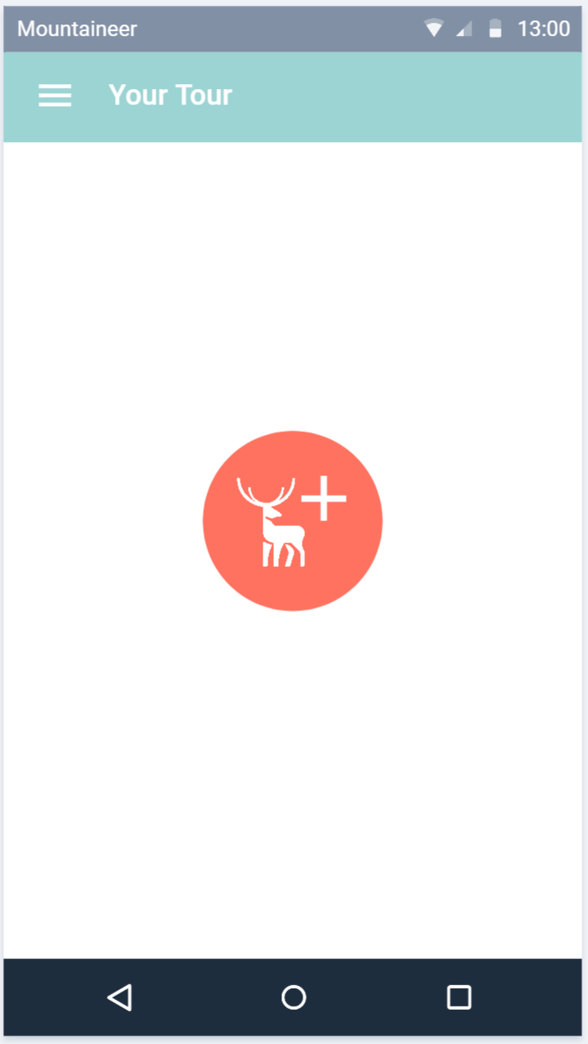
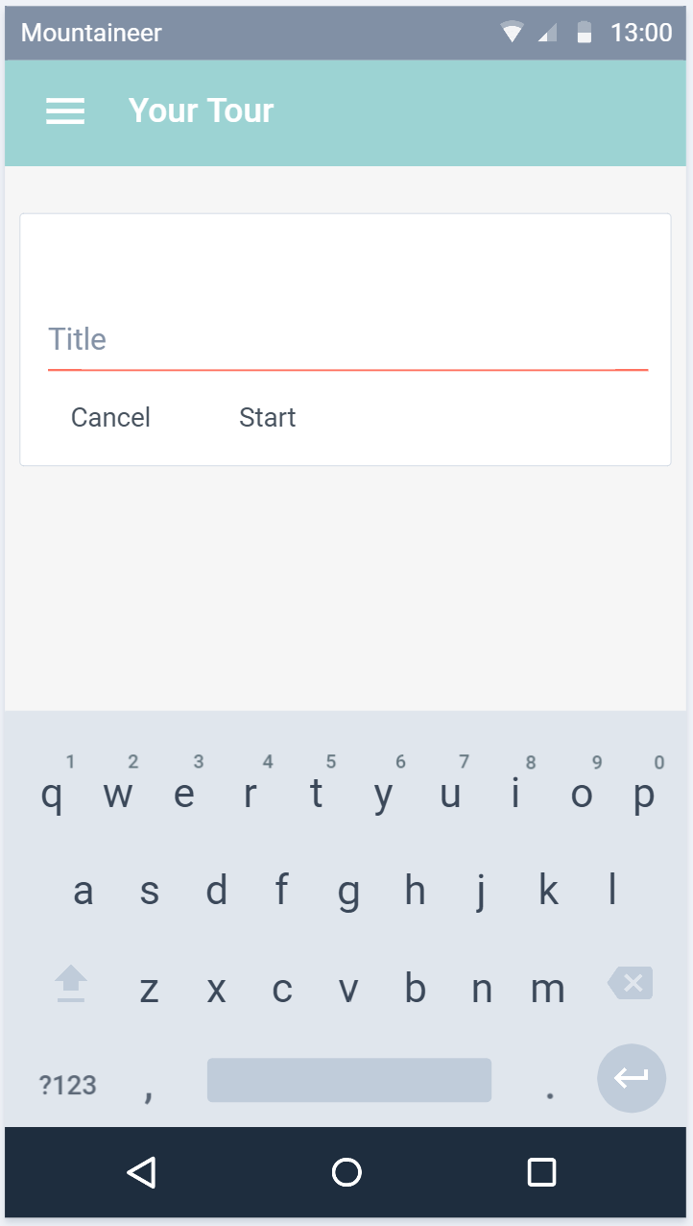
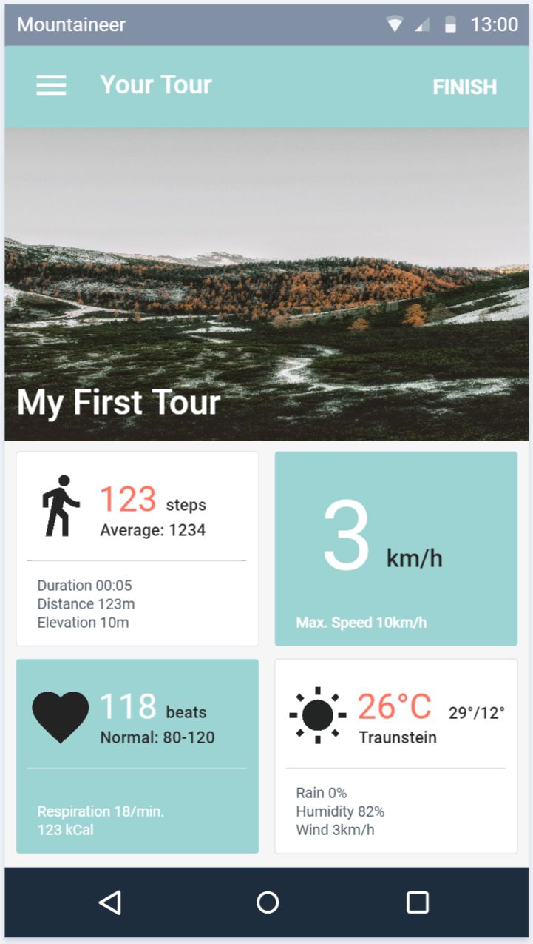
Planned Design
Subject to change without prior notice.

Slide 9
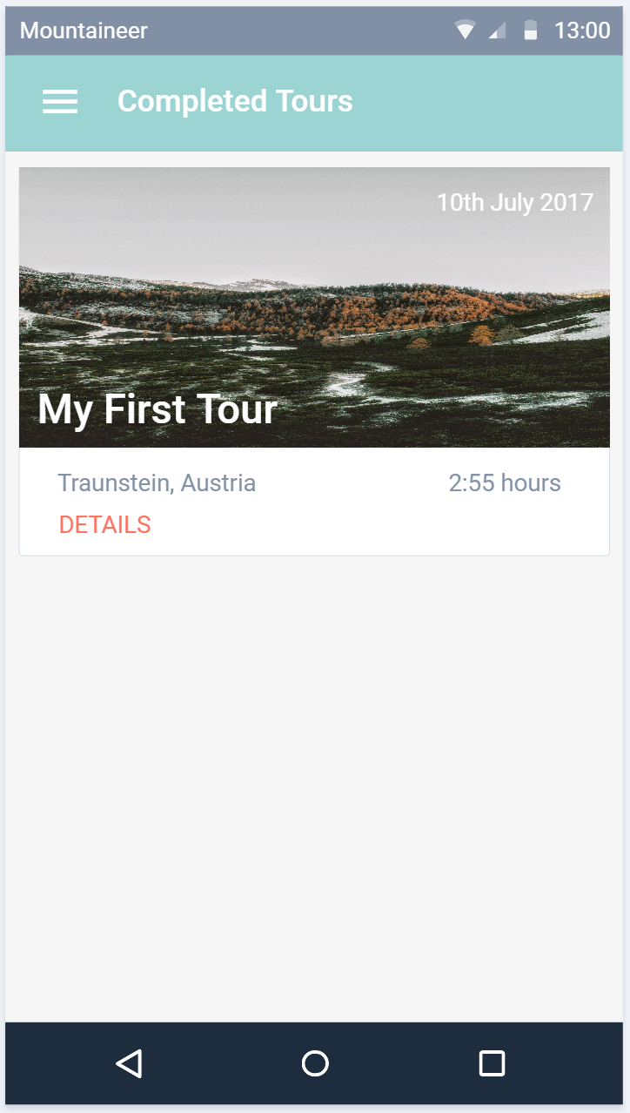
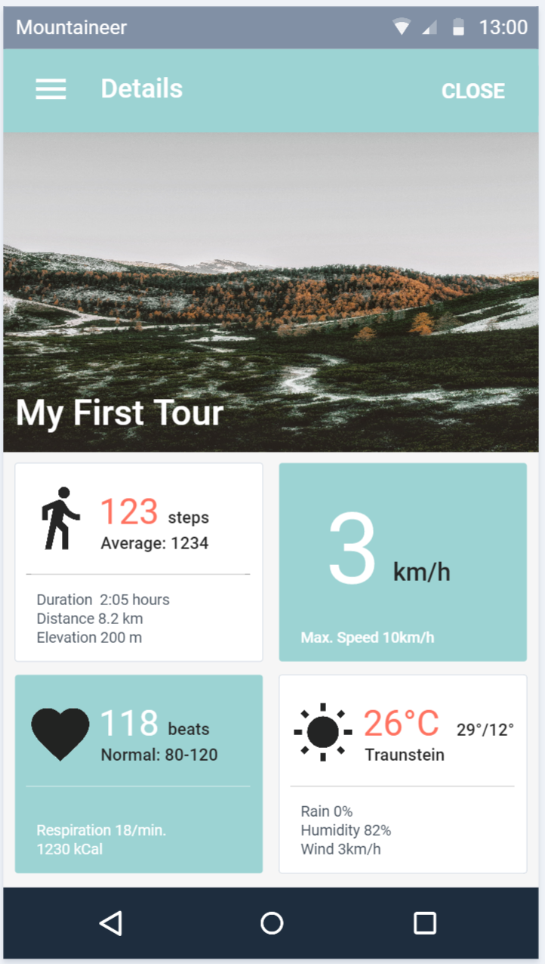
Planned Design
Subject to change without prior notice.

Slide 10
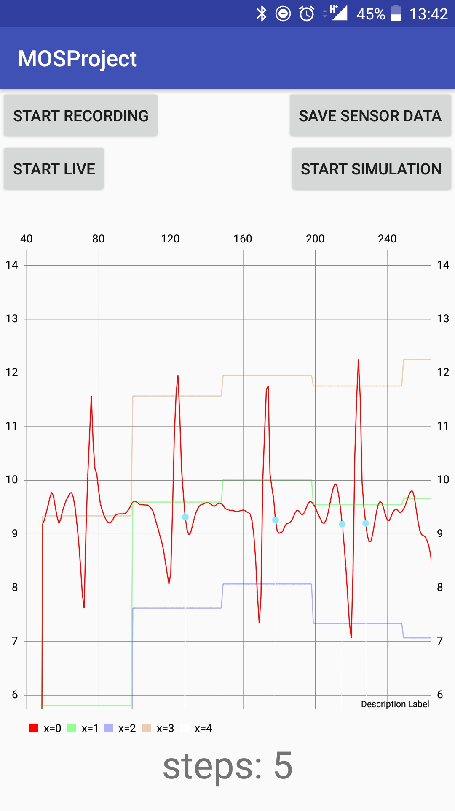
Pedometer
Simulation + Live-View
Graph
Used for debugging and testing
Firebase
Running as a Service
Implemented according to the PDF
But with little parameter adjustments

Slide 11
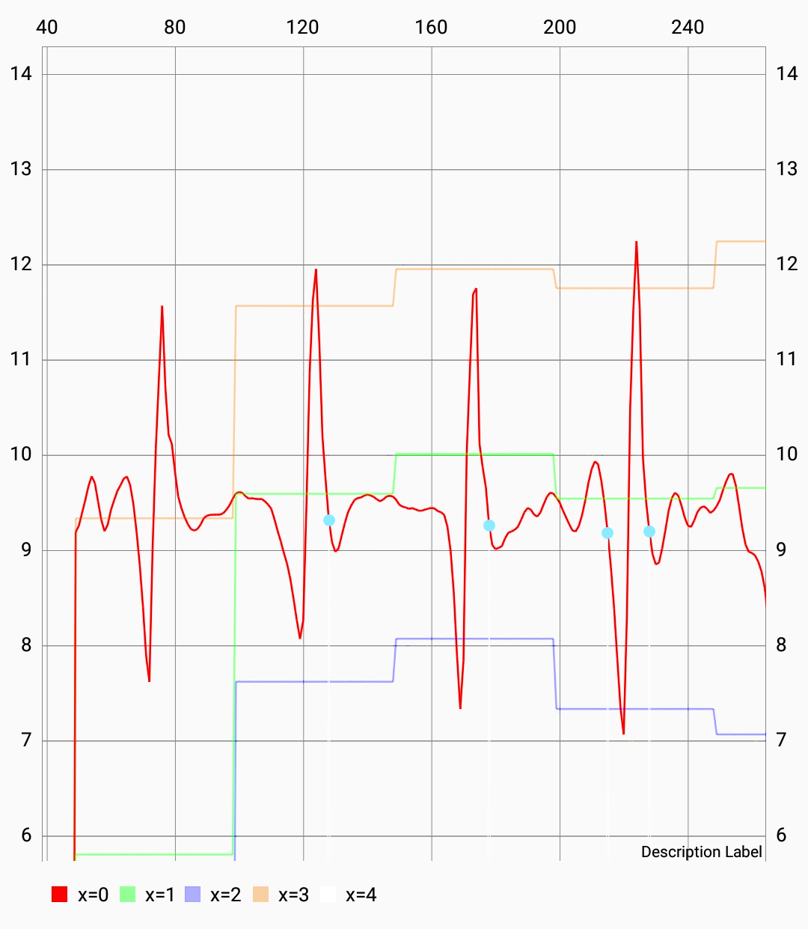
Chart Details
Measured values
Max + Min
Threshold
Detected steps

Slide 12
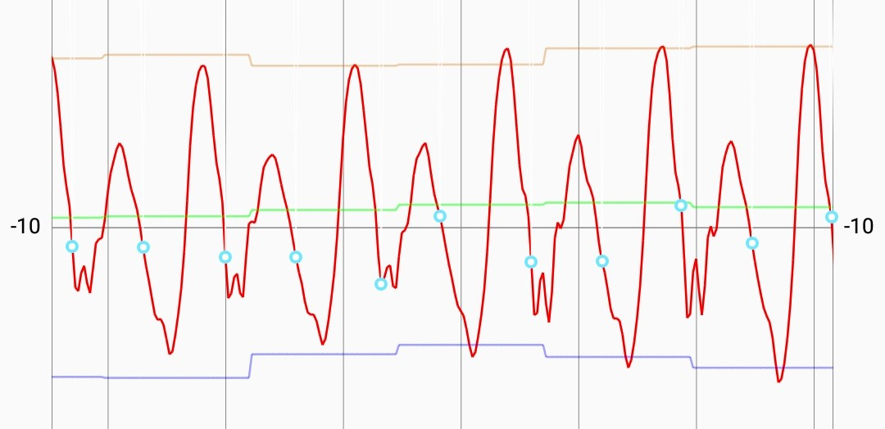
Acceleration of morning walk to FH

Slide 13
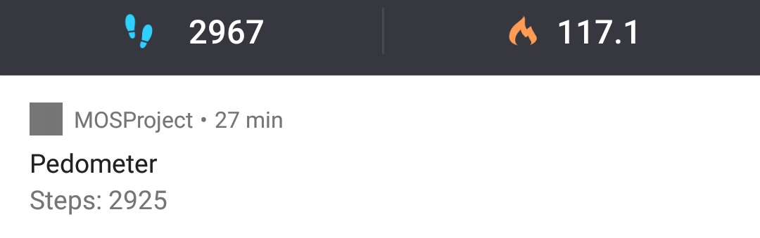
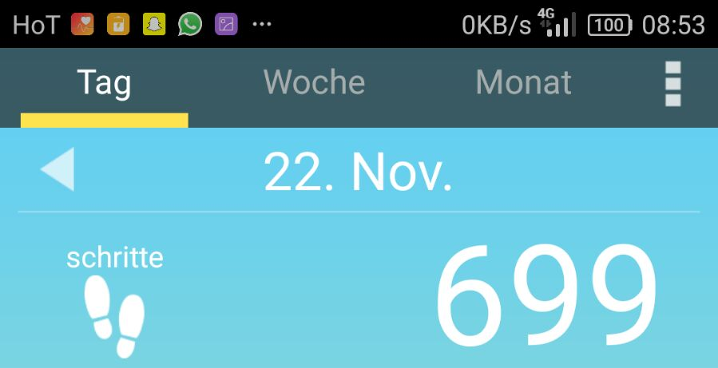
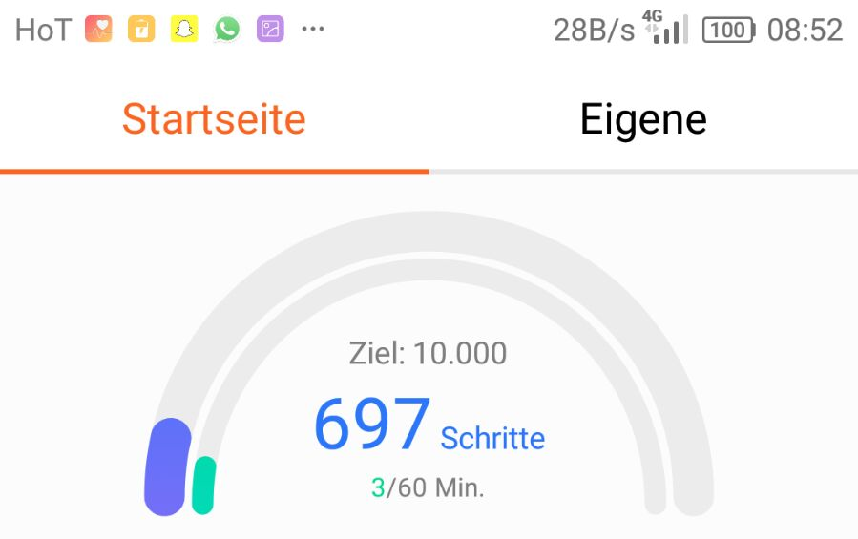
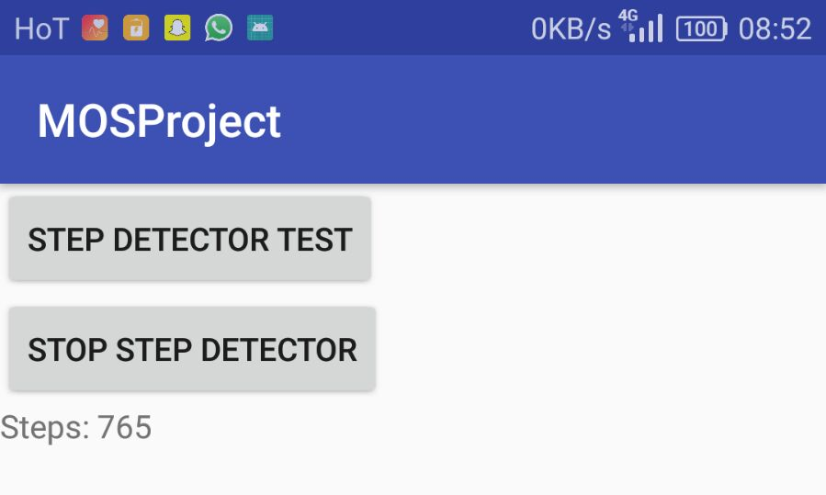
Competition Analysis
Accuracy compared to:
Pedometer
Huawei Health
Schrittzähler

Slide 14
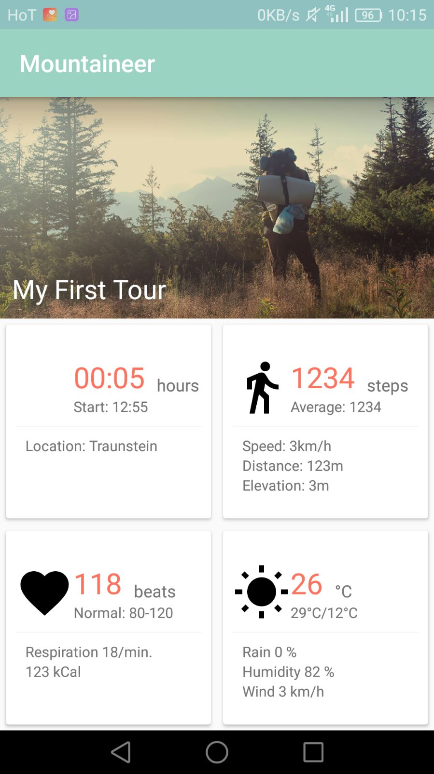
UI is (almost) ready
and waiting for functionality

Slide 15
Thanks!

Slide 16
Mountaineer
An Update.

Slide 17
Heart Rate Monitoring #1
Simulation of Heartrate Sensor
Bluetooth LE connection
Calculate
Fitness
Fatigue
Performance

Slide 18
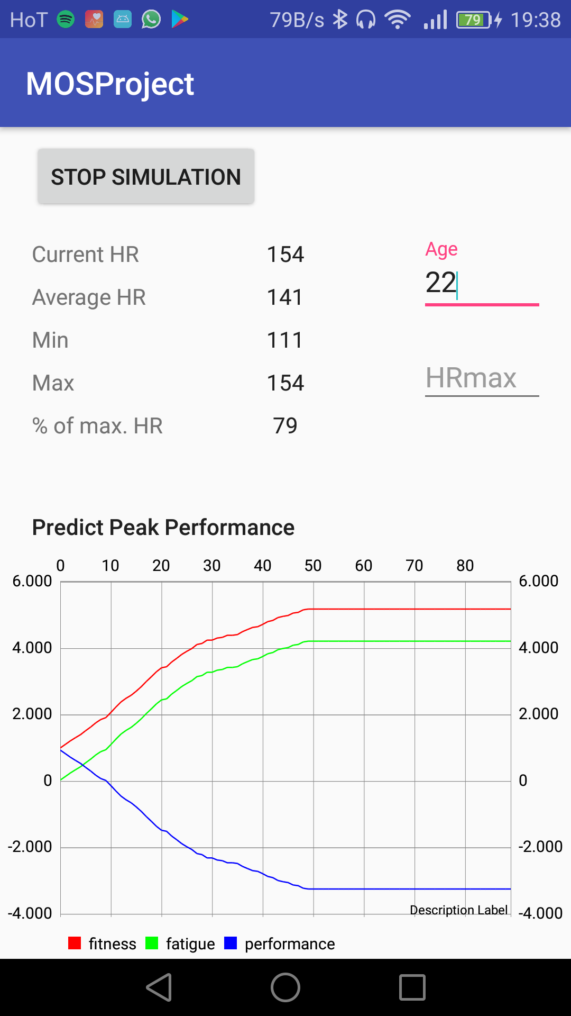
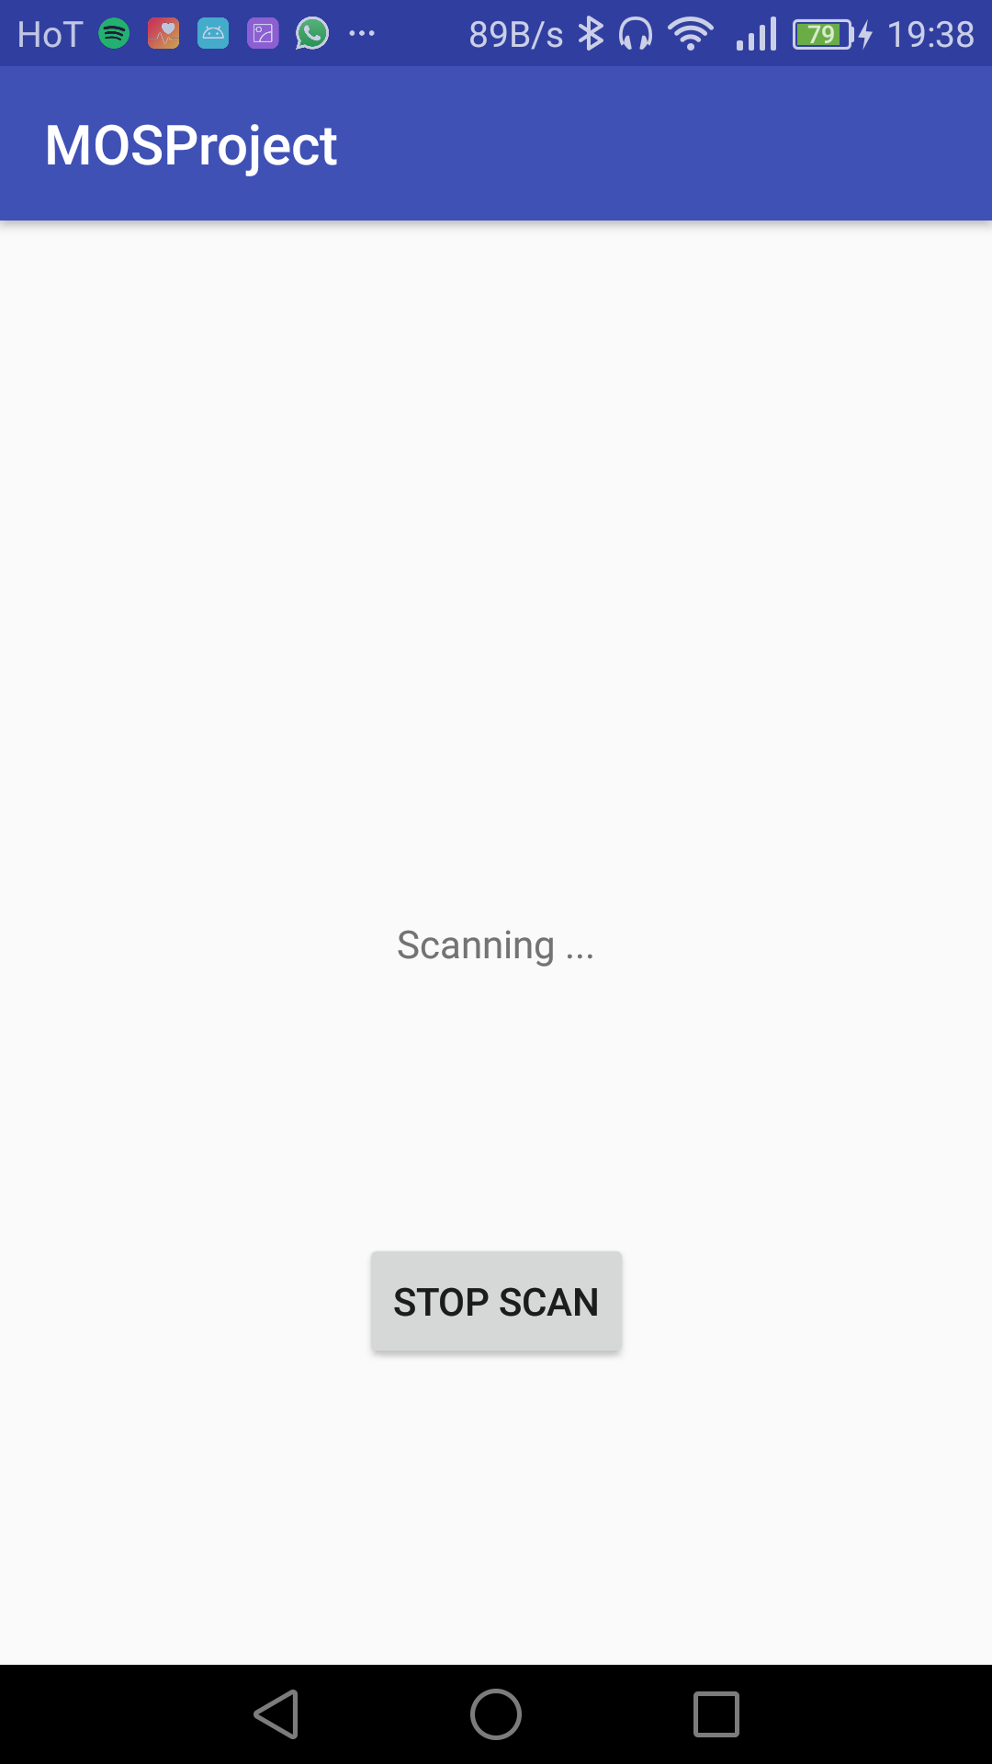
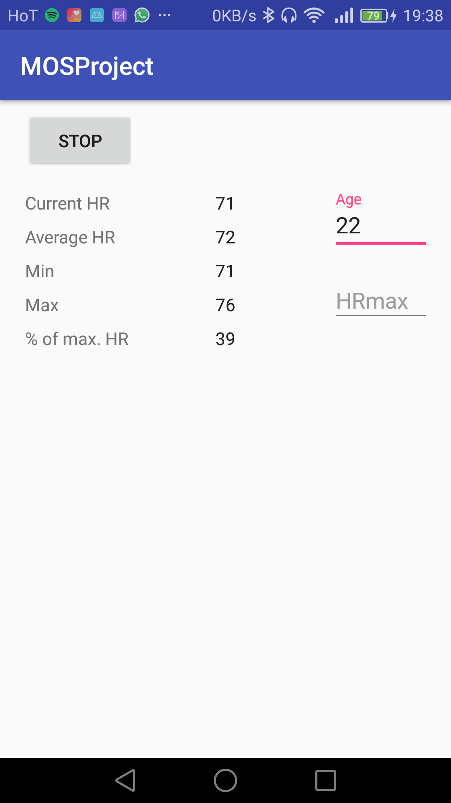
Heart Rate Monitoring #2

Slide 19
Heart Rate Monitoring #3

Slide 20
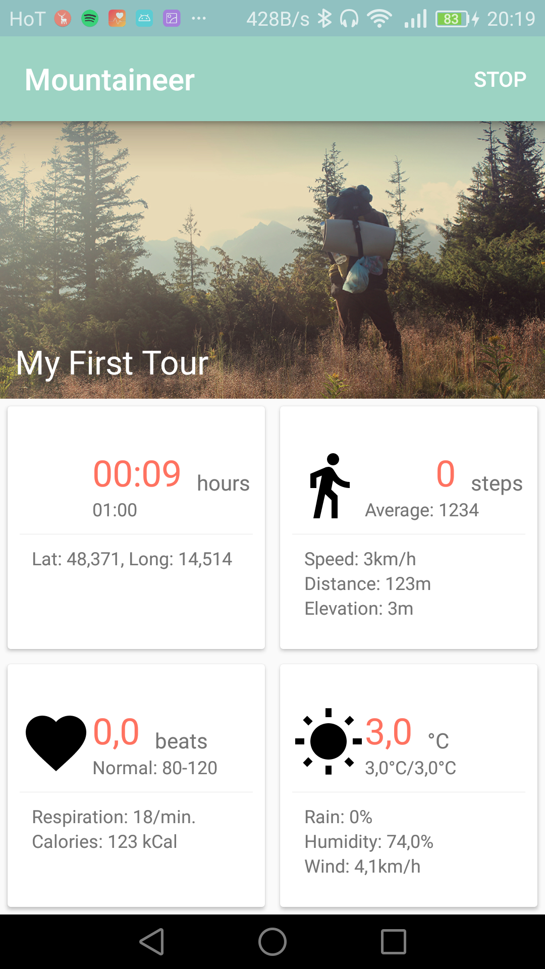
Android App #1
Basic Information
Stapwatch
Starttime
Location (GPS)

Slide 21
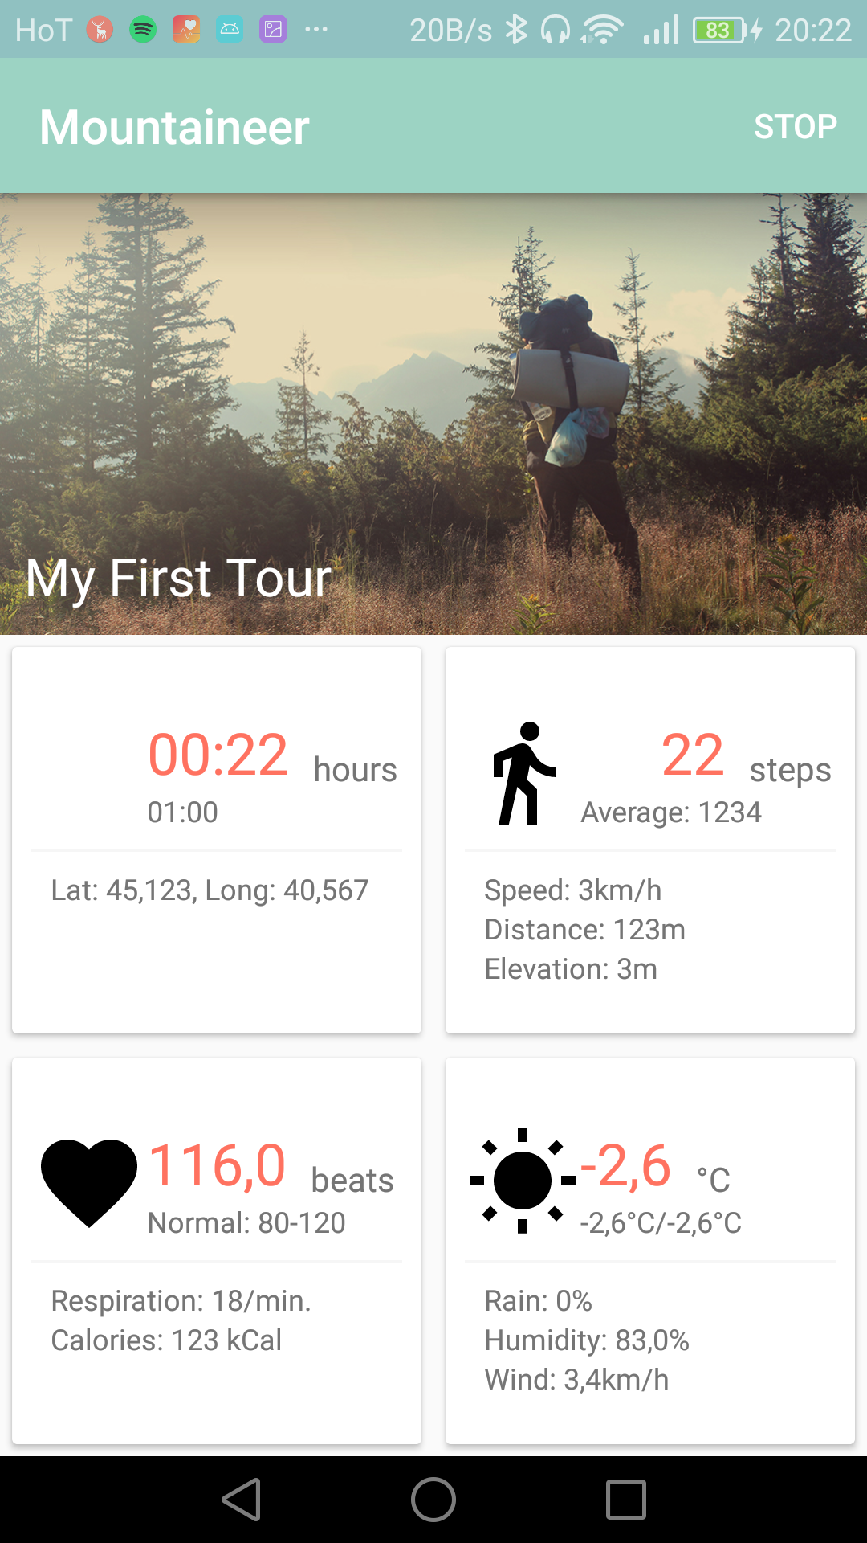
Android App #2
Step Count
Step Frequency

Slide 22
Android App #3
Heart Rate
Energy Expenditure
Bluetooth HR Monitor
Simulation

Slide 23
Android App #4
Weather Forecast
Temperature
Rain
Wind
OpenWeatherMap

Slide 24
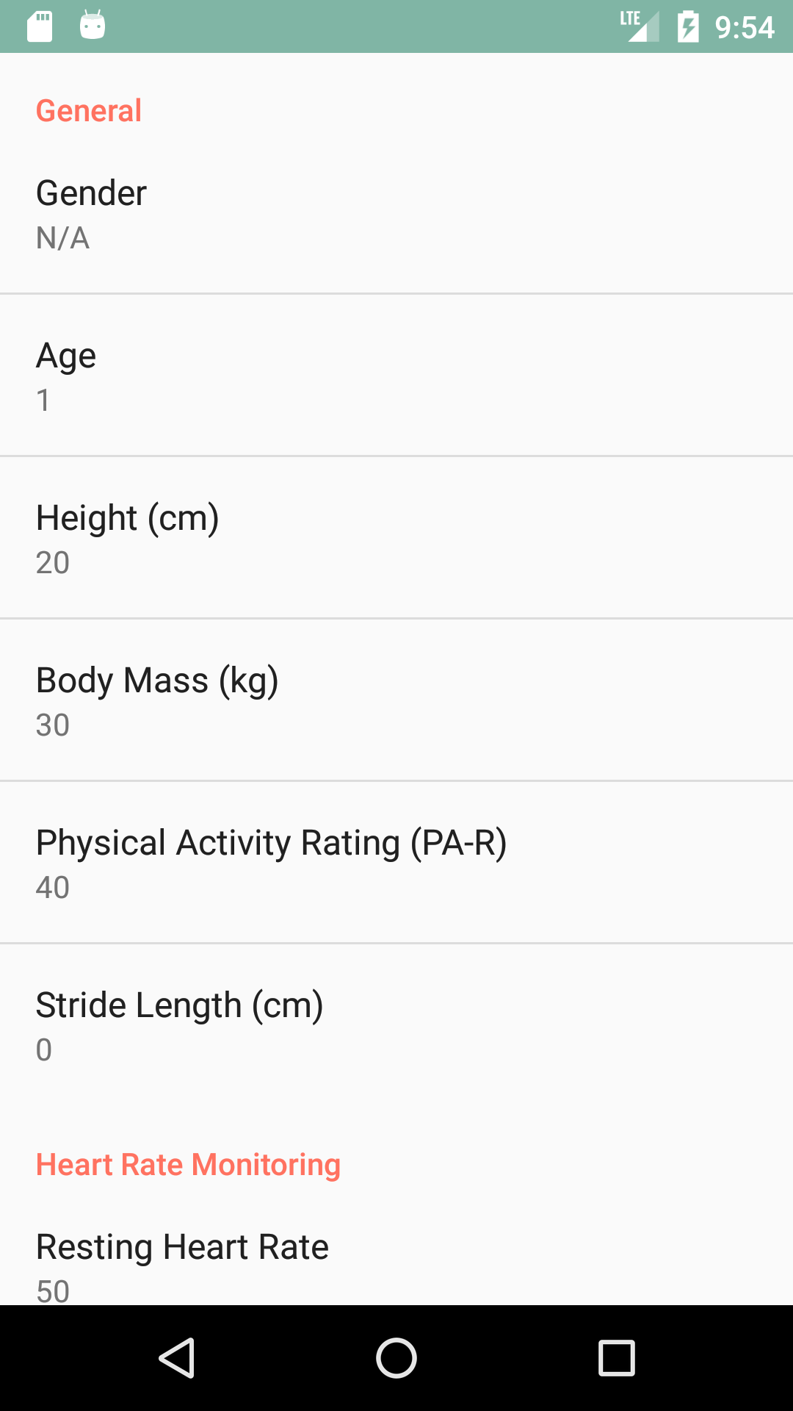
Android App #5
User Data
From Pedometer
Distance
Speed
Energy Expenditure

Slide 25
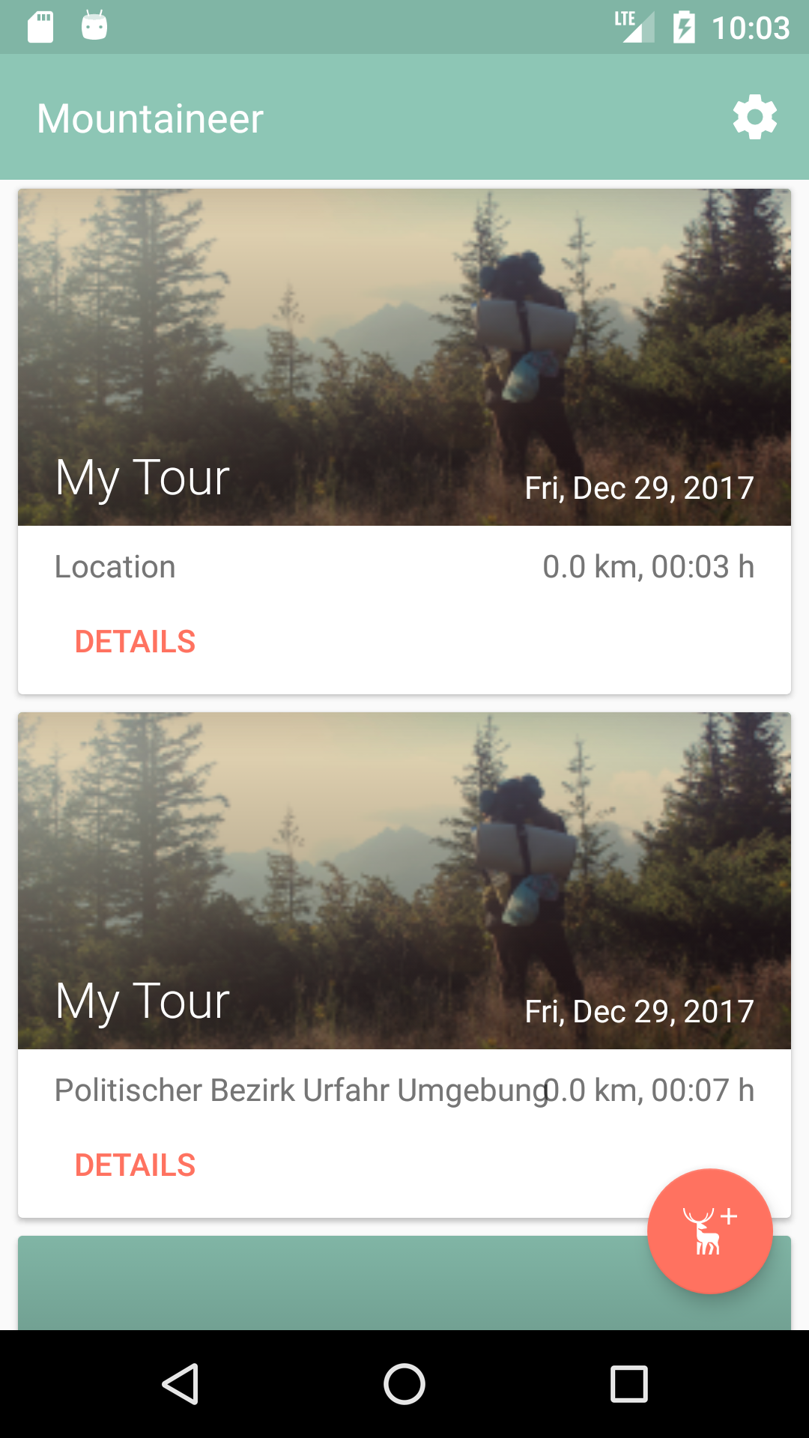
Android App Design #1
New UI
New Design

Slide 26
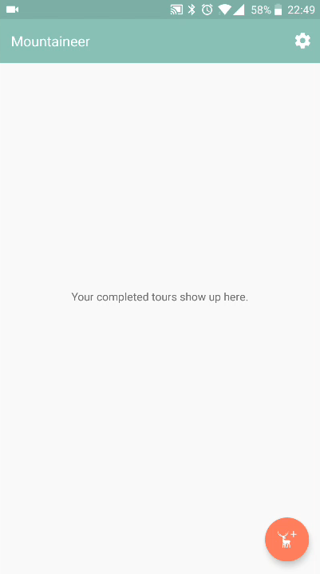
Android App Design #2
Demo!

Slide 27
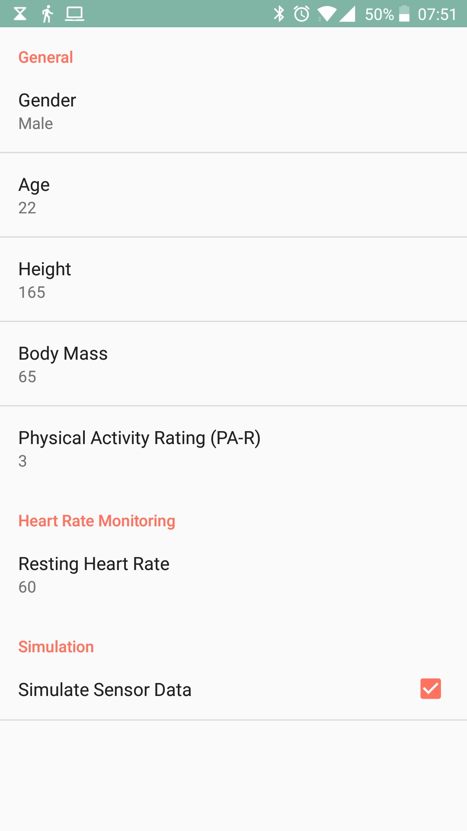
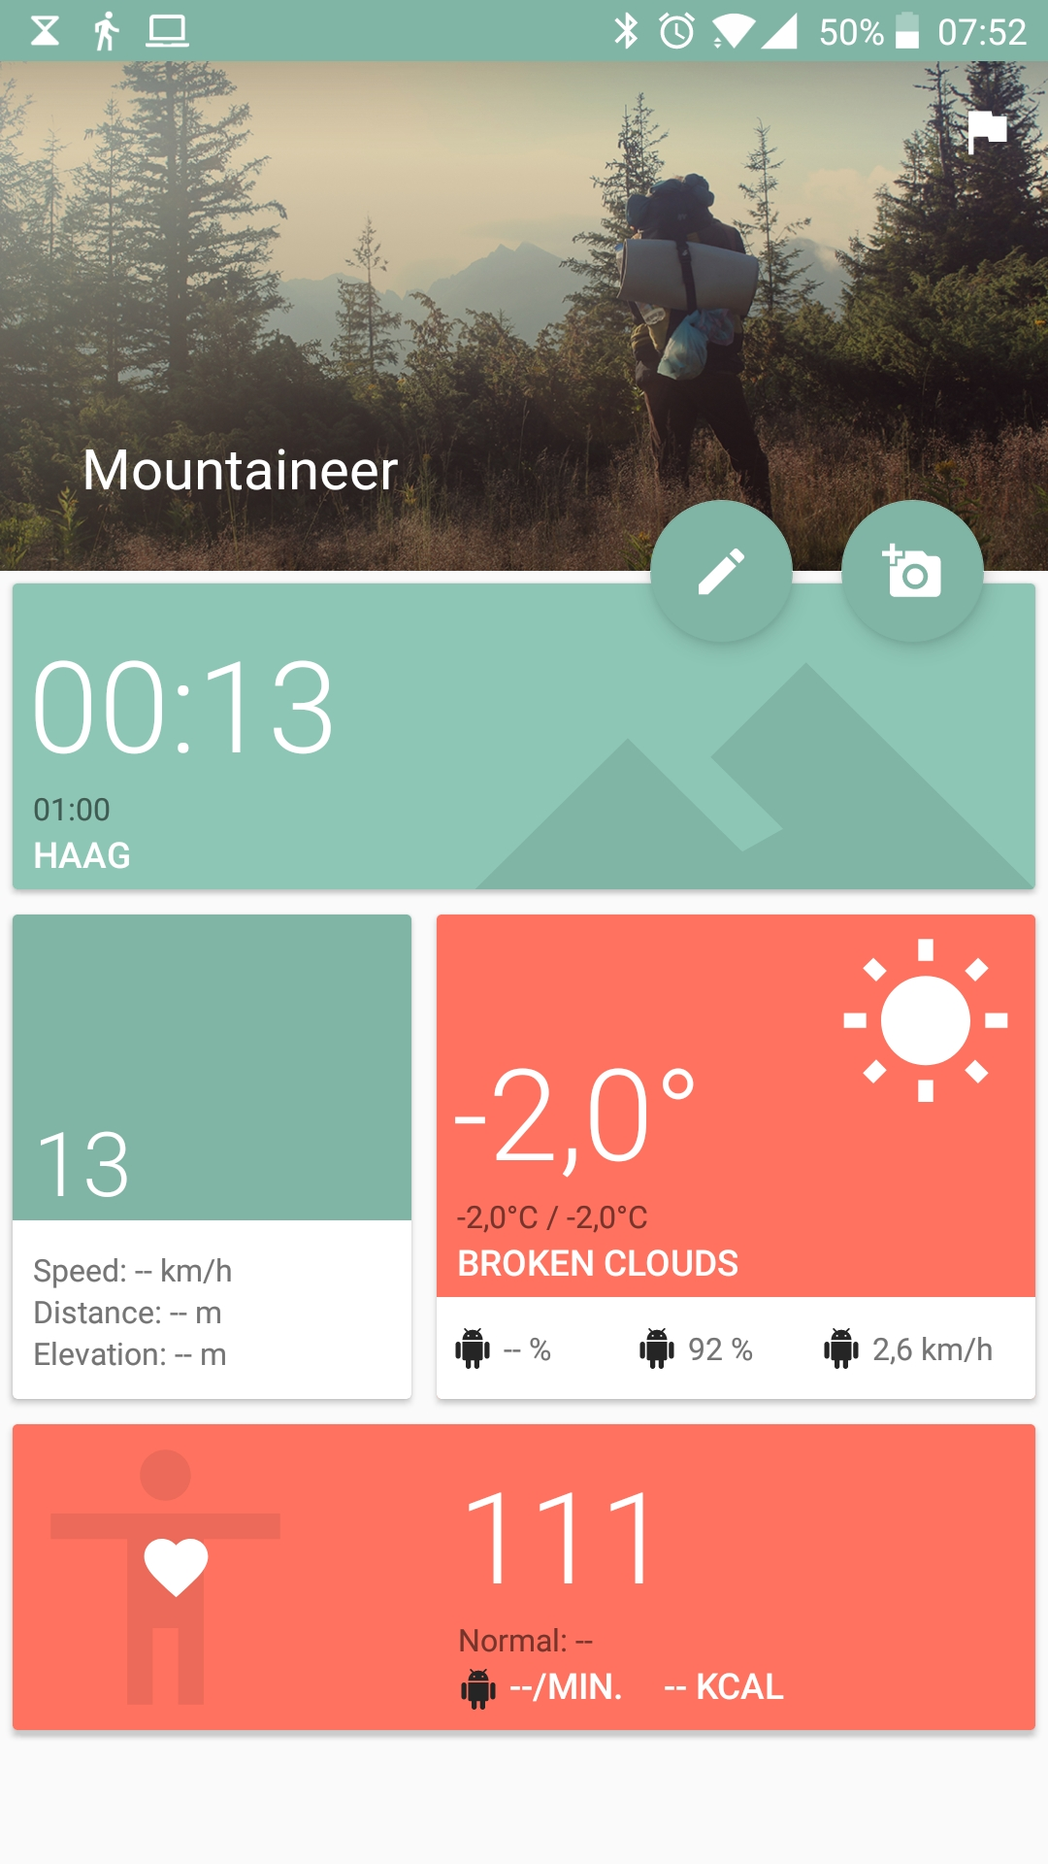
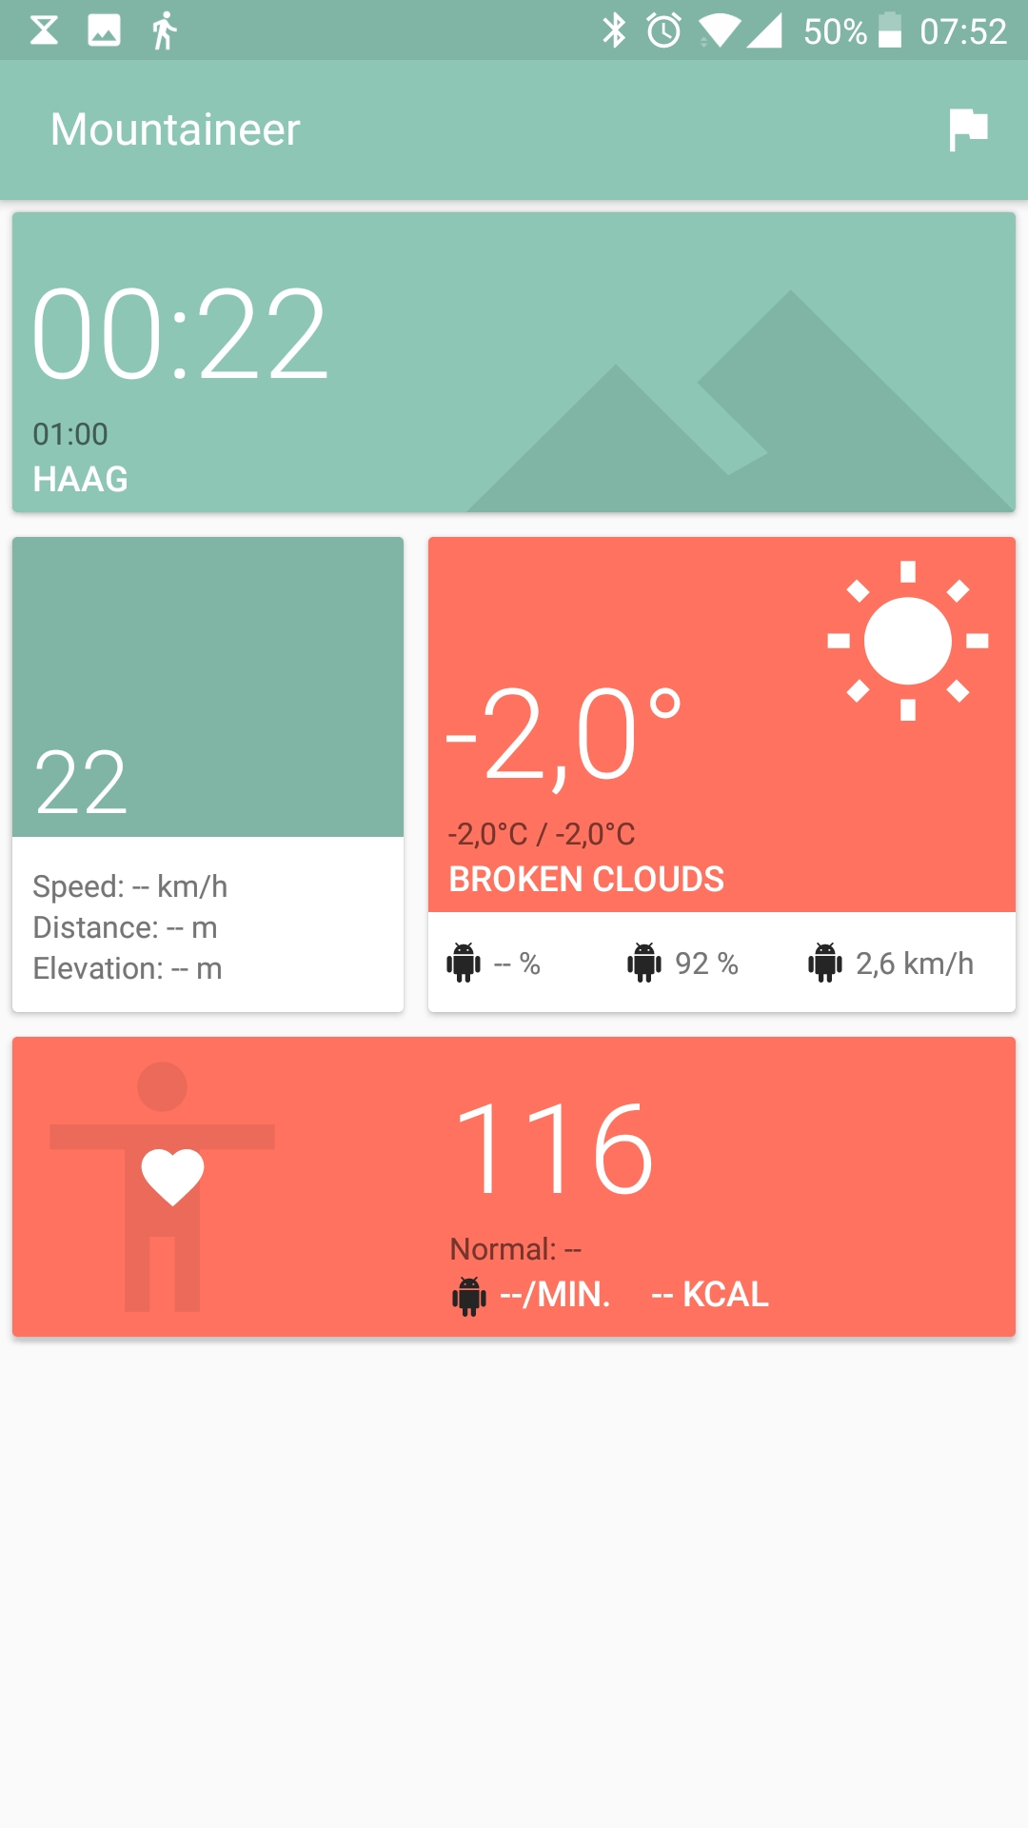
Android App Design #3

Slide 28
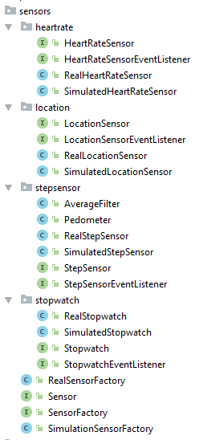
Behind the Scenes #1
Basically refactored everything
Factory Pattern
Interface for Everything!
Simulation for all Sensors

Slide 29
Behind the Scenes #2
Dependencies
Firebase
AndroidAnnotations
Retrofit
EventBus
Kotlin anyone?

Slide 30
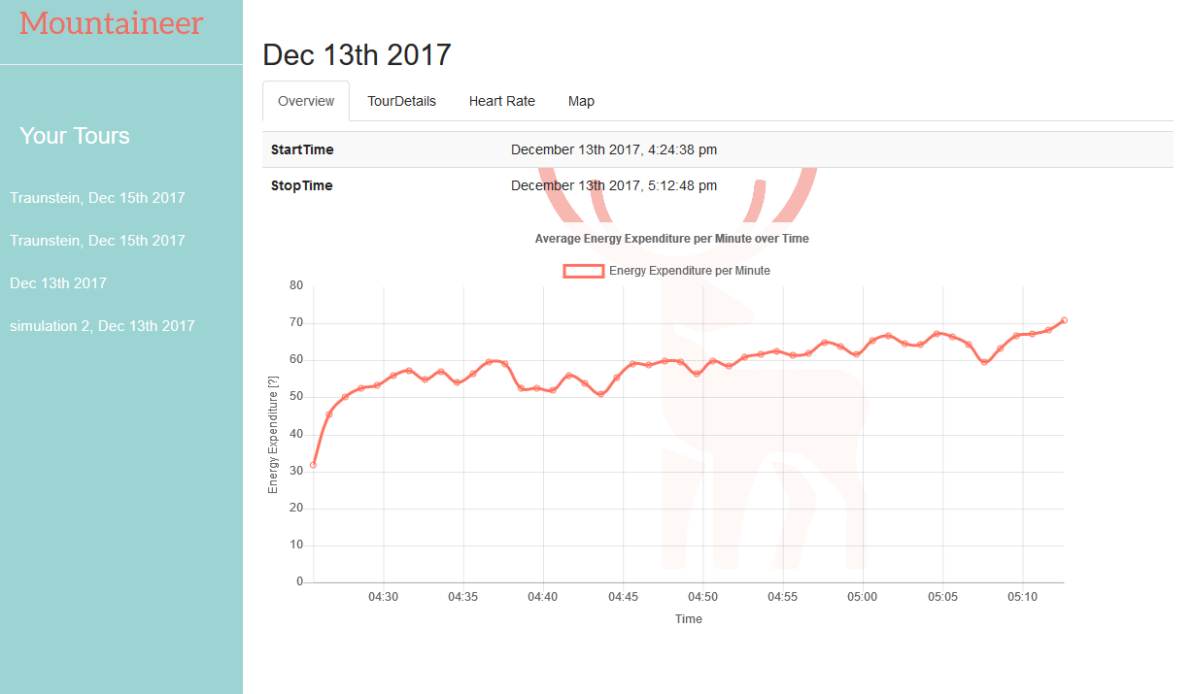
Website #1
Energy Expenditure

Slide 31
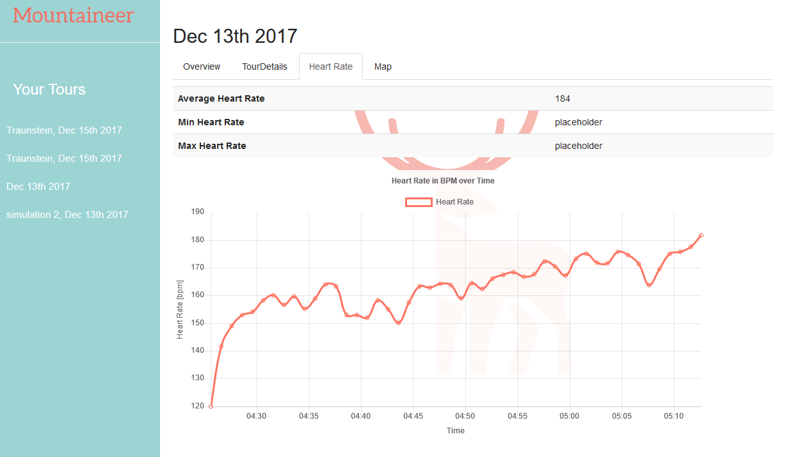
Website #2
Heart Rate

Slide 32
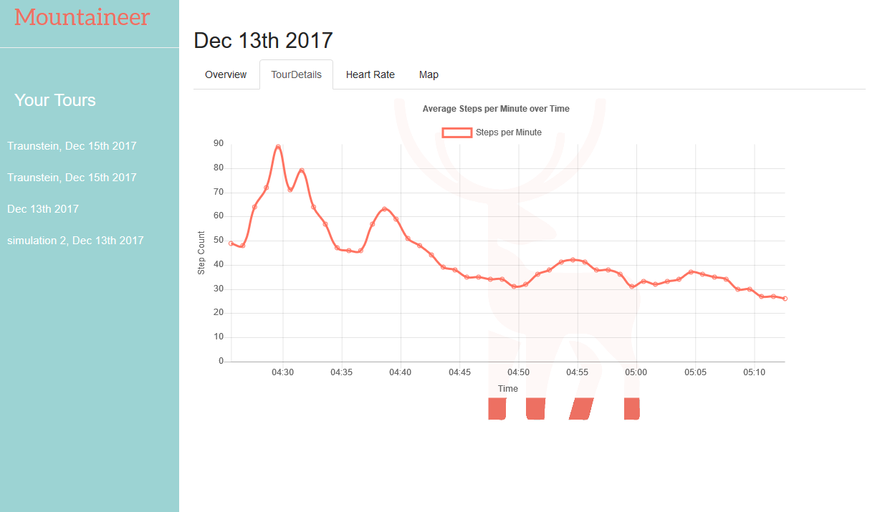
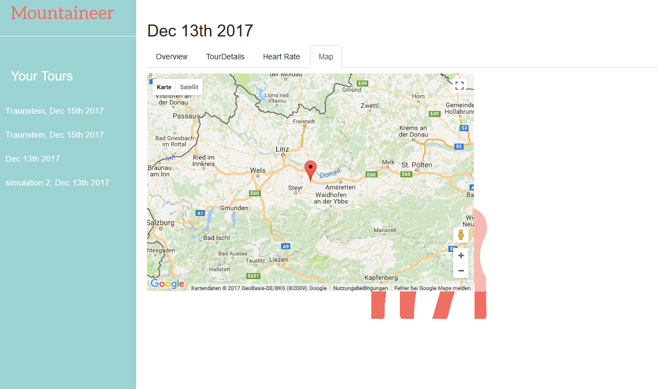
Website #3
Step Count, Map

Slide 33
Website #4
Single Page
Everything in JavaScript
jQuery - why not?
bootstrap - UI components
doT.js - template engine
firebase.js - database api
chart.js - charts
moment.js - date/time library

Slide 34
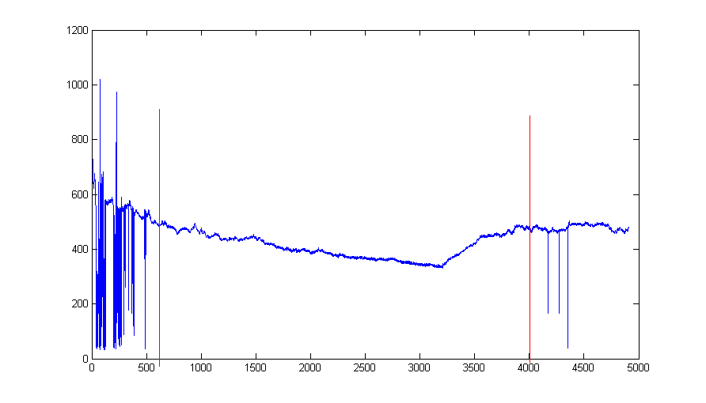
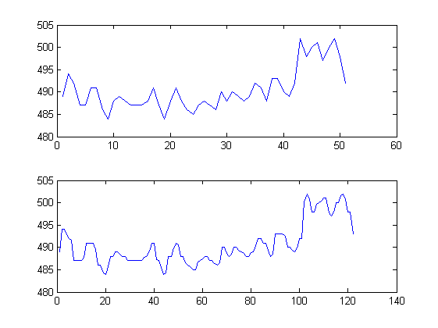
Respiration Frequency #1
Raw Data
Original Data
Resampled Data

Slide 35
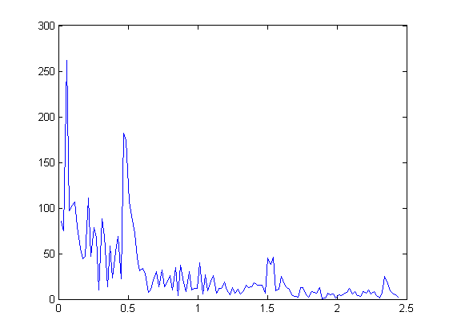
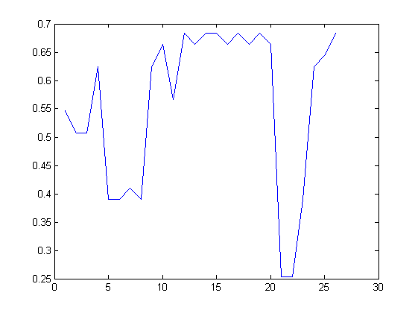
Respiration Frequency #2
FFT of 256 samples
Respiration Freq. Over Time

Slide 36
Respiration Frequency #3
Implemented in Matlab
Not sure if calculations are correct
Time (on x-axis) not correct

Slide 37
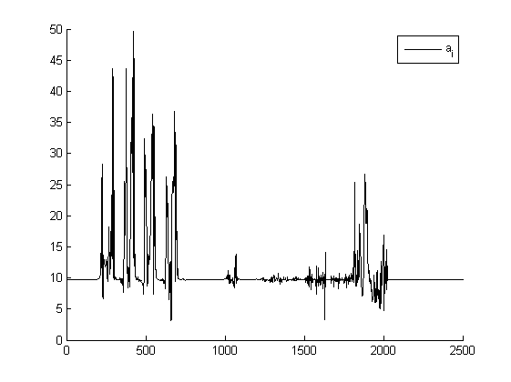
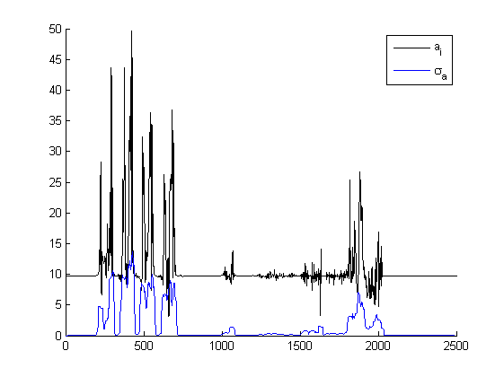
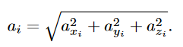
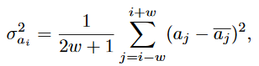
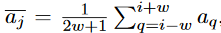
Detect Steps (Jiménez) #1
magnitude of acceleration
local acceleration variance

Slide 38
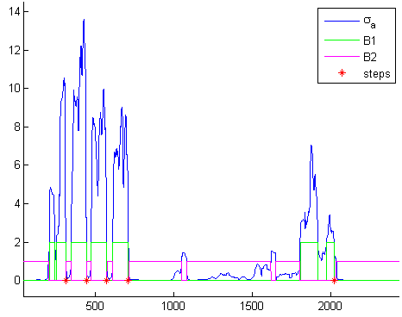
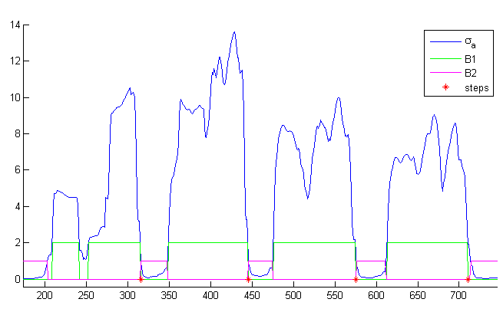
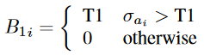

Detect Steps (Jiménez) #2
thresholds and steps
thresholds and steps (detailed)

Slide 39
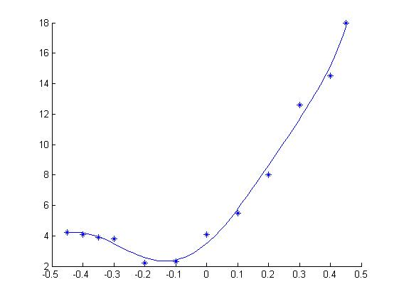
p = 447.6164 267.6918 -206.1911 -65.5996 60.2650 17.3737 3.4912

